Slide 1
SCM 651: Business Analytics
Week 3

Slide 2
Agenda
Google Analytics Access
Required for Homework #2
Homework #1
due before class in Week 4 live session (next week)
Review of concepts
Group discussion of articles
Web Analytics: Enhancing Customer Relationship Management
How eBay Uses Data and Analytics to Get Closer to Its (Massive) Customer Base

Slide 3
Week 3 - Review
One-way sensitivity analysis
Only one variable changes, allowing you to see the effect on the outcome
Two-way sensitivity analysis
Two variables changes simultaneously, allowing you to see the joint effect

Slide 4
Week 3 - Review
Conditional formatting
Colors, bars, icons to facilitate interpretation
When are some better than others?
Dashboards
Combine table and graphical representation

Slide 5
Week 3 - Review
Google Analytics: general measures
Visits, new visits, % new visits
Bounce rate, average visit duration
Google Analytics: locations
Countries, states, cities
Visits, new visits, % new visits
Google analytics: behavior
Frequency and recency
Engagement (length of time on site)

Slide 6
Week 3 - Review
Google Analytics: technology
Operating system & browser
Network provider
Mobile device
Google Analytics: visitor flow
Entry and exit point

Slide 7
Week 3 - Review
Google Analytics: Acquisition
Channels (organic search, referral, direct, social, email)
Source/medium (google/organic, direct/none, syr.edu/referral, bing/organic, va.gov/referral)

Slide 8
Week 3 - Review
Google Analytics: advertising
Advertising (key words, adwords)
Dayparting (time of day)
Google Analytics: social
Facebook, LinkedIn, Twitter, Google+

Slide 9
Week 3 - Review
Google Analytics: Behavior
Site content (ability to drill down to each web page for page views, average time on page, bounce rate, exit %)
Landing pages (first page viewed by user)
Exit pages (last page viewed by user)
Site speed, page timings, speed suggestions

Slide 10
Week 3 – New Material
Google Analytics
Realtime
Audience: Interests
Audience: Benchmarking

Slide 11
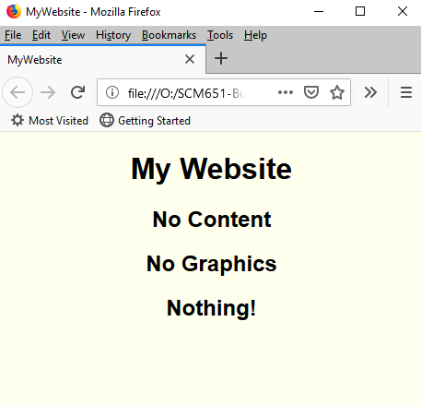
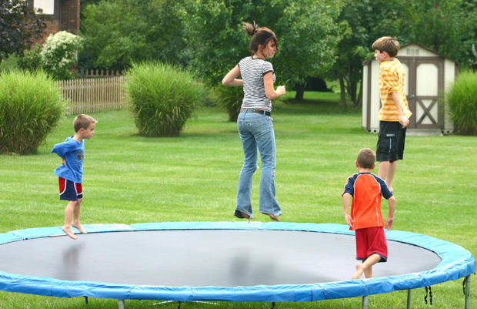
What do a trampoline and a bad website have in common?
A high bounce rate!
Trampoline
Bad Website

Slide 12
Google Analytics - Video
Video: Hal Varian, Google Analytics
https://www.youtube.com/watch?v=poas_GXSou8#t=142

Slide 13
Article #1: Web Analytics
Web Analytics: Enhancing Customer Relationship Management
Describe the four main categories of metrics and relate to the Google analytics lessons
Website usability; Traffic sources; Visitor profiles; Conversion statistics
Describe the common techniques for Web analytics
Clustering/classification; Association rules; Path analysis; Sequential patterns
What are some business applications of web analytics?

Slide 14
Article #2: How eBay Uses Data
How eBay Uses Data and Analytics to Get Closer to Its (Massive) Customer Base
What is an A/B test and what is its purpose?
Describe the three biggest challenges of web data
Data at a large scale
Collecting the right data
New kinds of data
How can Power Sellers use data better?
Why are web analytics better than surveys?

